Slide 1

Section 4 Project
US House Price Trend Analysis

Slide 2

Executive summary
The business case
Selecting regions to invest in:
Growth regions
Modelling growth
Risk vs. reward
Forecasted gains
Possible next steps
Appendix contains additional analysis

Slide 3
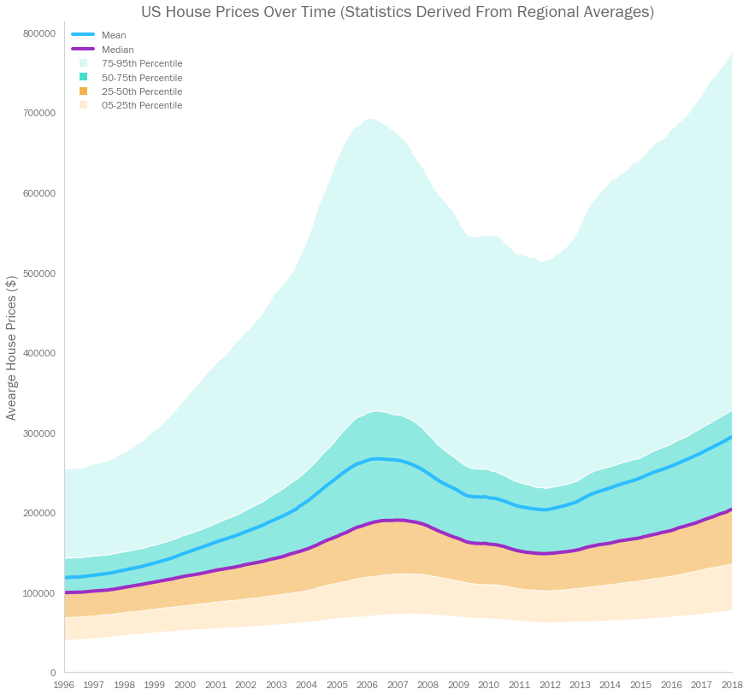
The business case – the market at a glance
The US housing market has been volatile in the last two decades, driven by the house price bubble and subsequent crash in 2007
Spread has increased dramatically over time. Regions in the 95th percentile now have average prices ten times higher than those in the 5th

Slide 4
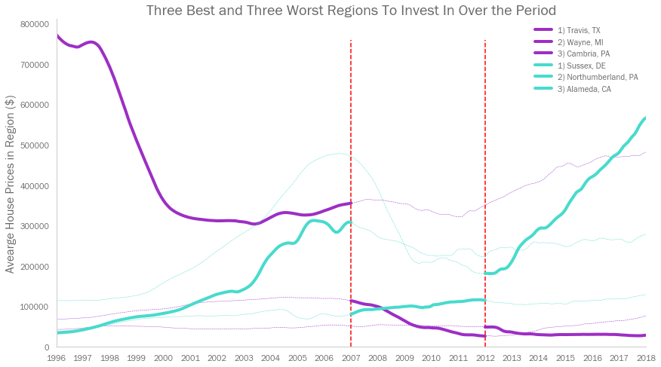
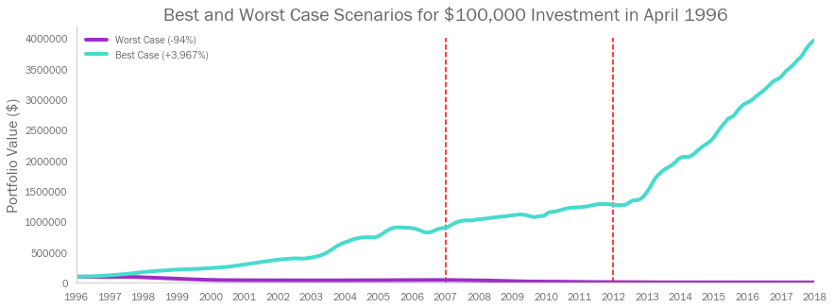
The business case – getting the best returns
Property value growth has varied wildly at a regional level
Accurately predicting prices in a region can help an investor to make significant returns
Worst case investments
Best case investments
By investing in the fastest growing region from 1996, then moving assets favourably at the ‘07 market peak, and again at the ‘12 market trough, a canny investor could have seen an overall return of 4,000%

Slide 5
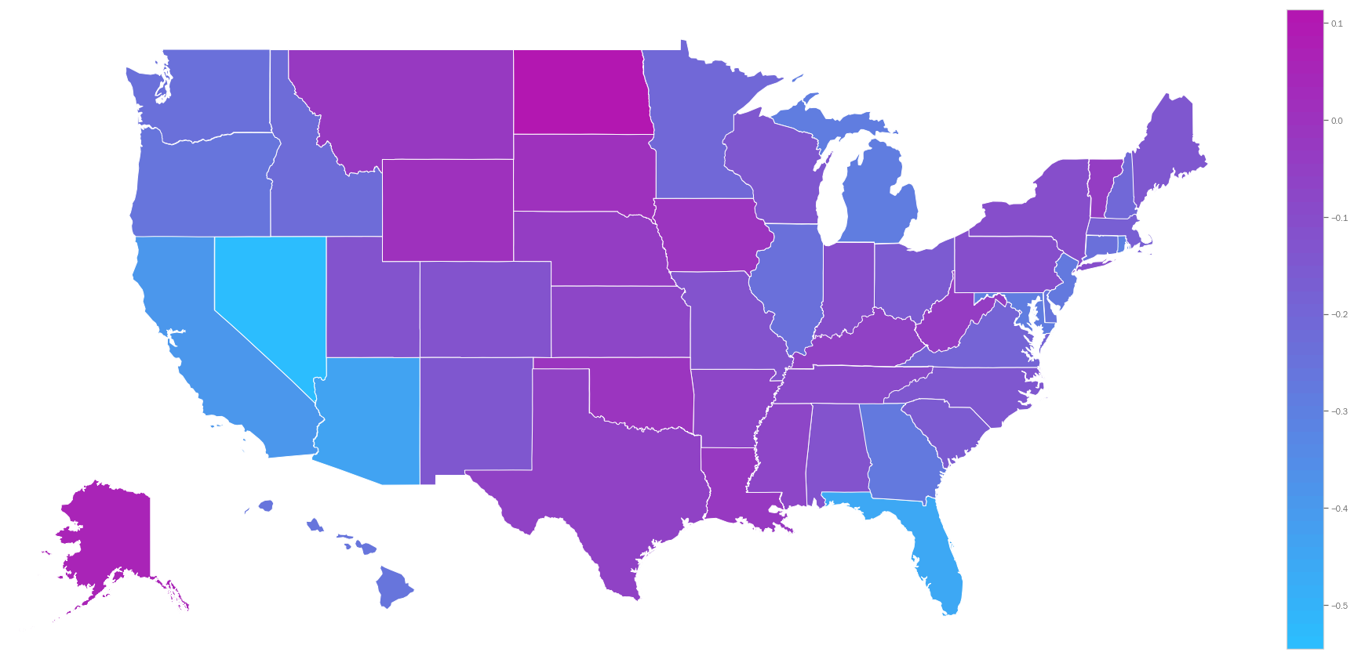
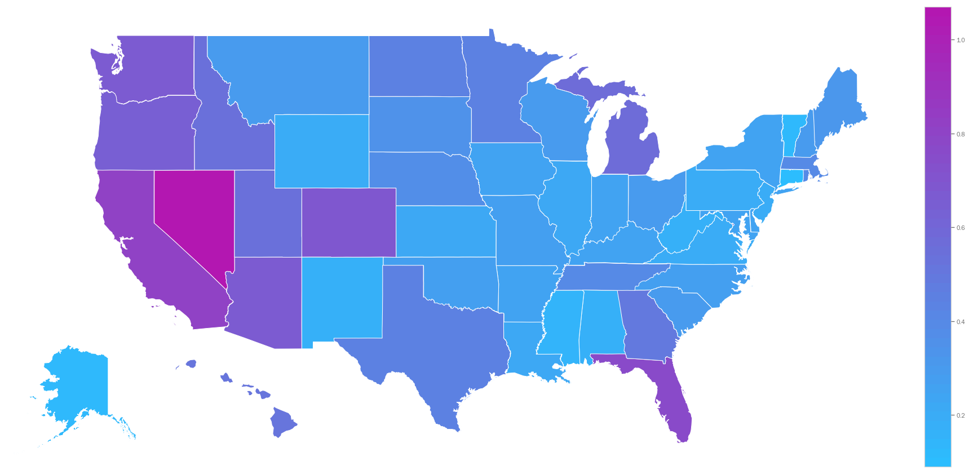
Selecting regions – state by state
April ‘07 – April ‘12 Average Region Price Growth by State
Trend has not been felt consistently across the country – especially during economic downturns
Many regions with strong recent growth have simply been recovering from downturns
We should consider the risk of a region’s vulnerability to economic shocks when choosing where to invest
April ‘12 – April ‘18 Average Region Price Growth by State

Slide 6
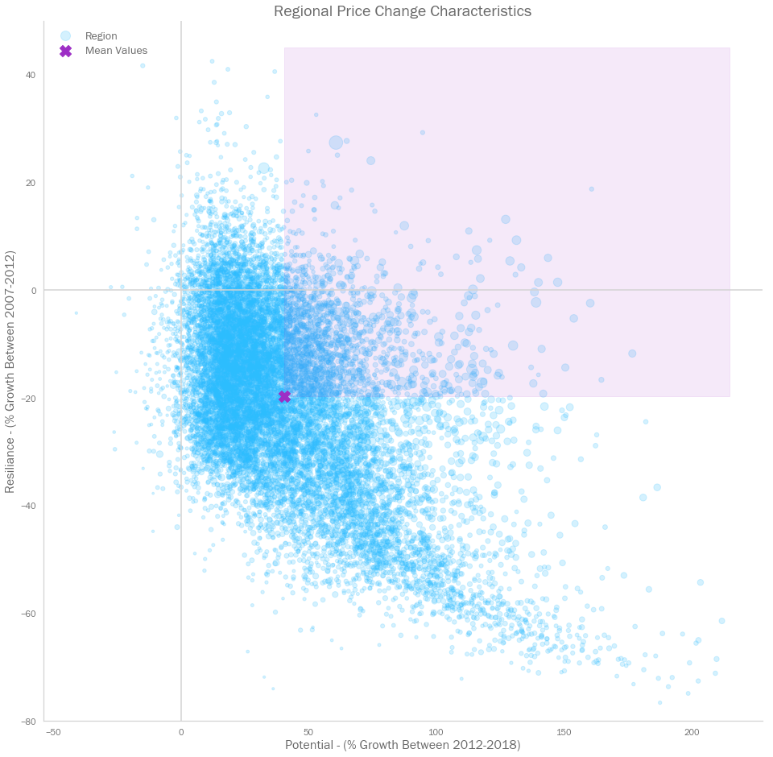
Selecting regions – ‘Growth Regions’
CB91 narrowed down the initial 14,103 regions by considering how their values changed in the two key periods before and after 2012
It isolated those regions that had above average growth in the downturn between 2007 and 2012, then above average growth from 2012 to 2018
This left 1,737 (12%) so-called ‘Growth Regions’ for further consideration
Growth Regions

Slide 7
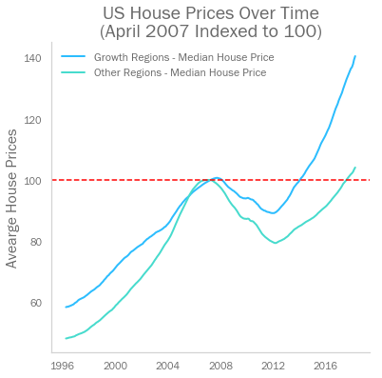
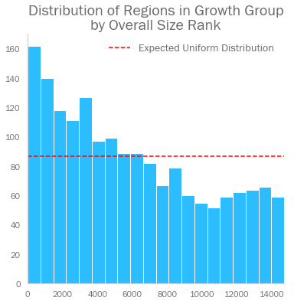
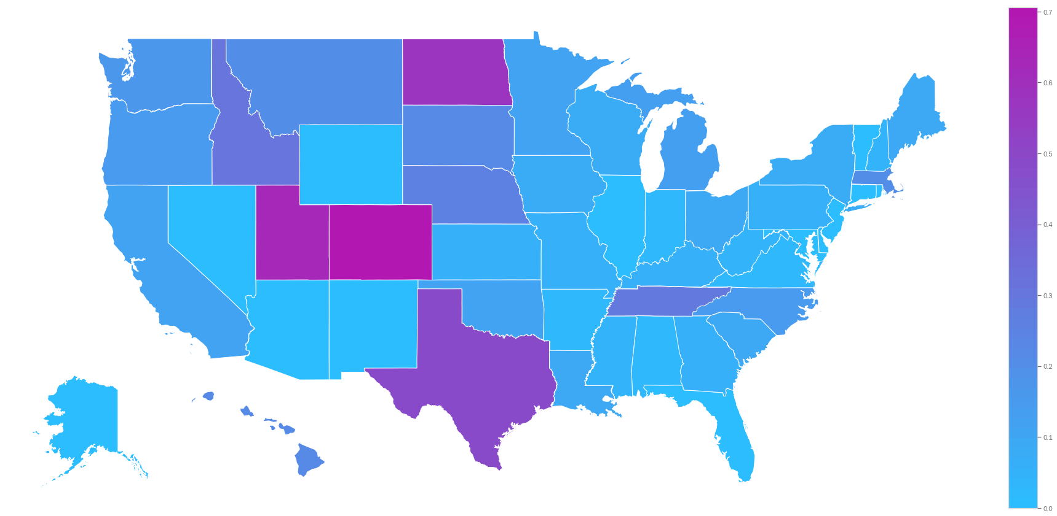
Selecting regions – ‘Growth Region’ characteristics
Growth Regions have grown faster since 2007, but also grew more slowly up to 2007
Growth Regions tend to be larger on average than non-growth regions
A high share of regions in Colorado, Utah, North Dakota, and Texas are Growth Regions
Larger regions
Share of State’s Regions in ‘Growth Group’

Slide 8
Forecasting house prices – model building
CB91 has used ARIMA models to forecast house prices on a region-by-region basis
This kind of modelling has advantages:
ARIMA modelling can deal with a wide range of time series types
We can fit a bespoke model for each region, allowing us to account for growth dynamics specific to that region
We can forecast a range of future values, within a given confidence interval
However, there are limitations we should be aware of:
It can not account for freak exogenous events, such as the financial crisis
Sometimes, data is such that no ARIMA model can be fit. In these cases, we do not consider the region for investment, as its prices are evidently too unpredictable

Slide 9
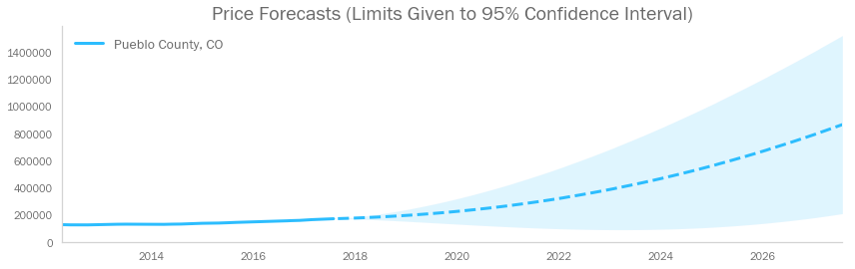
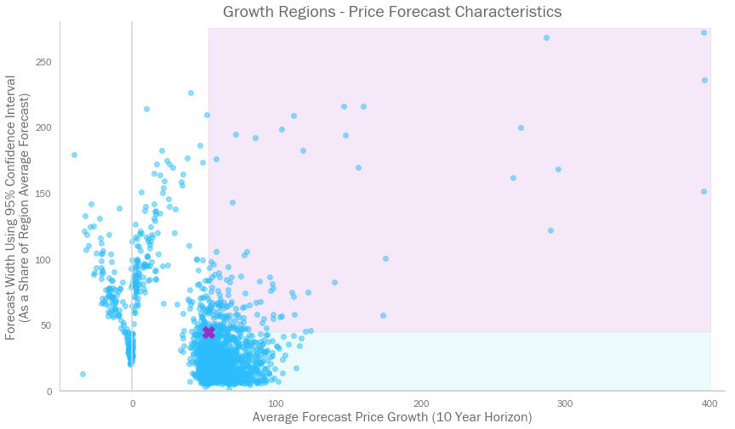
Forecasting house prices – risk vs. reward
Some regions are forecast to experience very strong growth
However, some forecasts come with a very wide range – and would therefore make for risky investments
We should select regions that have strong growth potential, but limited risk
Pueblo County could have returns of anywhere between 21% and 766% in 10 years
High Risk High Reward
Low Risk High Reward

Slide 10
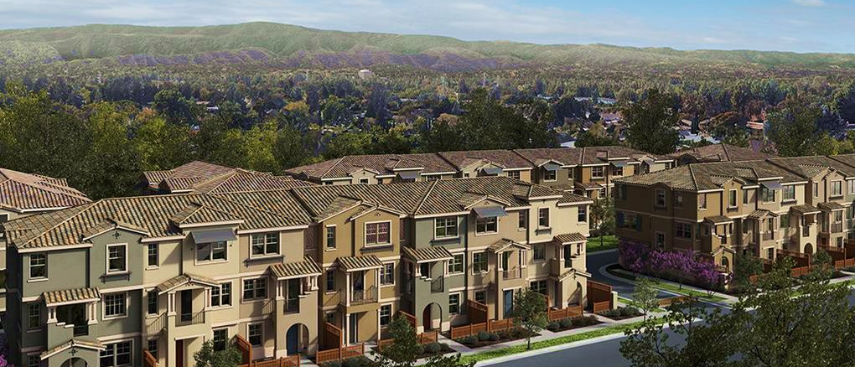

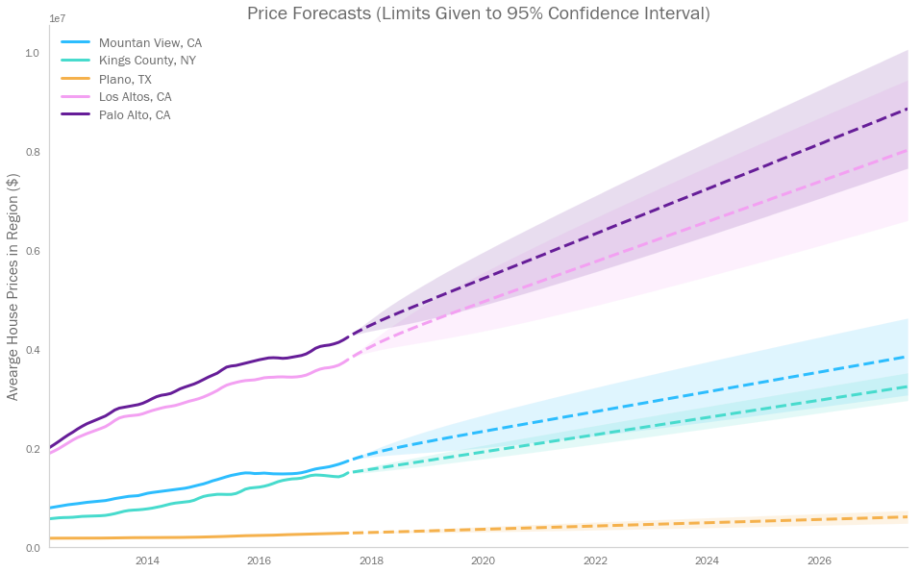

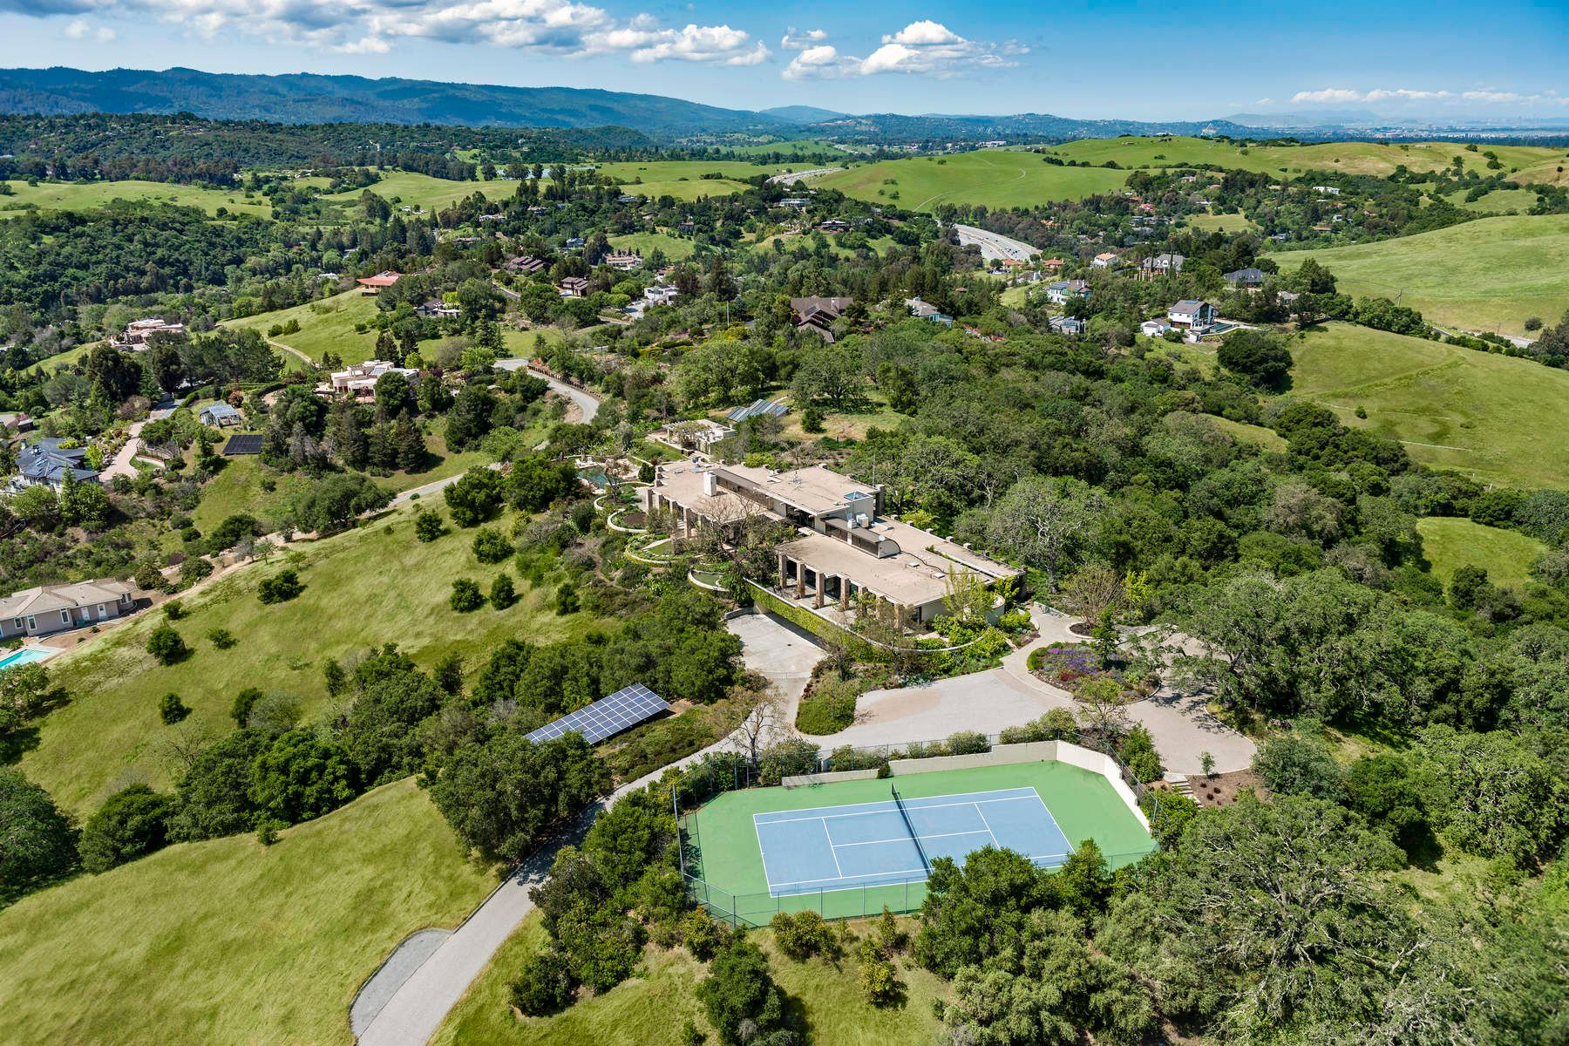

CB91’s recommended regions
CB91 have isolated the 5 regions with the strongest growth potential, but with below average risk, over a 10 year horizon
Mountain View, CA
Kings County, NY
Plano, TX
Los Altos, CA
Palo Alto, CA

Slide 11
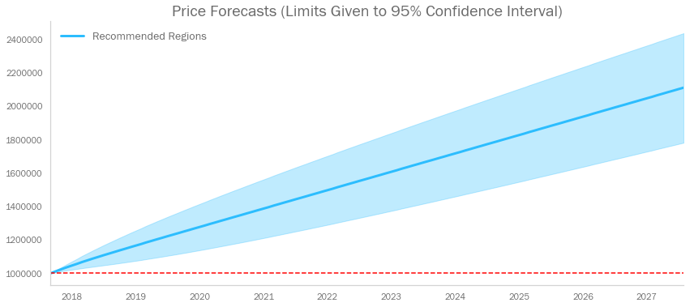
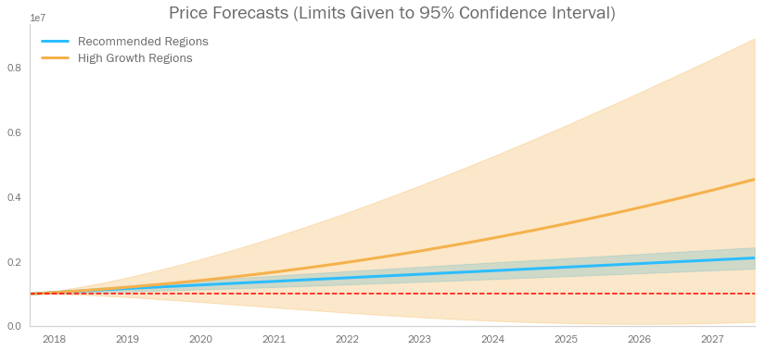
CB91’s recommended regions
By investing $1m evenly across the 5 recommended regions, CB91 predicts returns of 112% by mid 2028
We predict with 95% confidence, that the portfolio would be worth between $1.78m and $2.43m
Note – this is a narrower range than simply investing in the 5 regions with highest forecast growth (which has the potential to lose 86% of its value by 2028)

Slide 12

Possible next steps
There are further steps we could take to improve the analysis and tune our recommendations. We could:
Investigate the full selection of zip codes, as opposed to just the ‘Growth Group’
Use ‘dynamic modelling’, which would narrow confidence intervals
Create a function that advises how to split investment across regions, depending on the client’s risk appetite

Slide 13
Thank you for your time
Further detail on the model, and additional analysis of the dataset is included in further pages

Slide 14
The ARIMA model – in more detail
ARIMA modelling is a way of forecasting the future values of time series by using previous values.
There are three key components of an ARIMA model:
AR I MA
An ARIMA model is said to have order (p,d,q)
Auto Regression
Calculate the next term based on the values of the last p terms, using an individually defined coefficient for each of those terms
Integrated Term
If this is non-zero, then ’difference’ the dataset by d periods.
In other words, transform the time series from its original values to the difference between values at time t, and time t-d.
This is used in cases where we have a general drift in the data.
Moving Average
Calculate the next term based on the error from the moving average

Slide 15
The ARIMA model – in more detail
ARIMA modelling is a way of forecasting the future values of time series by using previous values.
There are three key components of an ARIMA model:
1) Auto Regression
Calculate the next term based on the values of the last p terms, using an individually defined coefficient for each of those terms.
2) Integrated Term
If this term is non-zero, then ’difference’ the dataset by d periods.
In other words, transform the time series from its original values to the difference between values at time t, and time t-d.
This is used in cases where we have a general drift in the data.
3) Moving Average
Calculate the next term based on the error from the moving average
An ARIMA model is said to have order (p,d,q)

Slide 16
The ARIMA model – recommended regions
CB91 ran Monte Carlo simulations across the revenue per customer across six regions

Slide 17
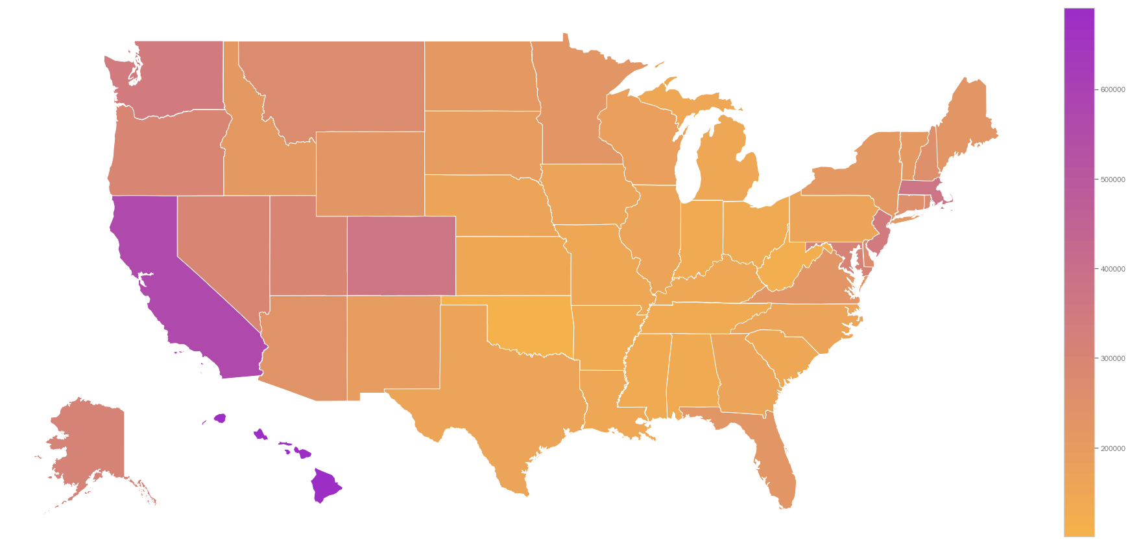
Median regional house price by state
Additional Analysis
California and Hawaii are the two most expensive states in the country, with median regional house prices of $567k and $691k respectively.
Though not as expensive as California or Hawaii, we also see that the ‘next highest’ prices tend to be found nearer the coasts, with Oklahoma having the least valuable regions on average.

Slide 18
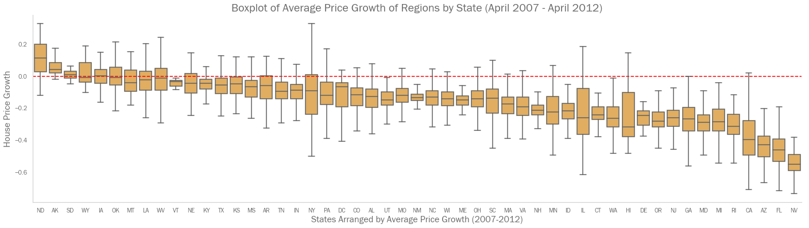
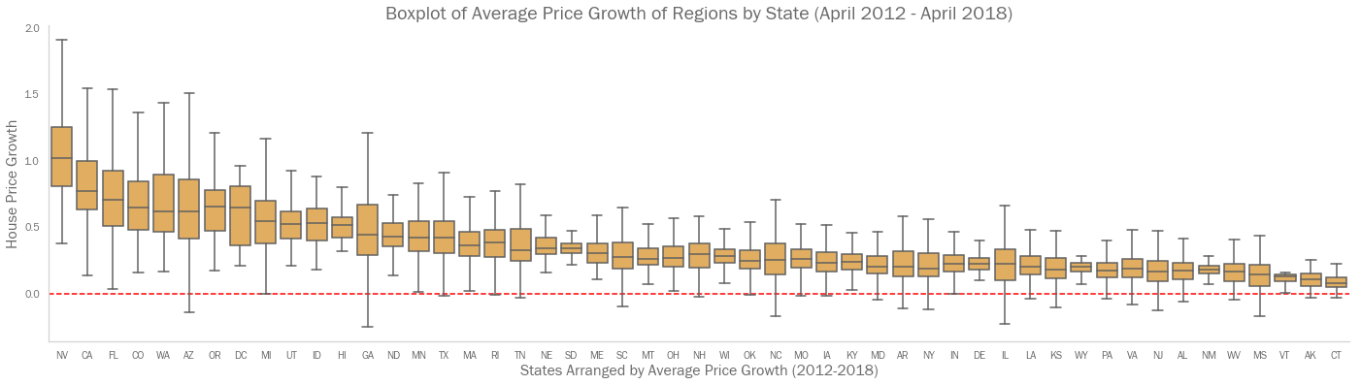
Distribution of regional house price growth by state
Additional Analysis
Here we see just how badly some states suffered from the 2007 crisis. We also note the variance of regional growth within states.
Many states with stronger growth from 2012 were those most affected by the crisis, though the variance of regional growth within those states was very wide.

